Slide 1


Interactive Corridor

Slide 2
Team
Robbe De Wispelaere
Scrum master
Hardware
Aitor Vannevel
Backend
server
Simon Stijnen
Backend
Website
Niels Denoo
Documentation
Hardware

Slide 3
The assignment
Creating atmosphere in the hallway
Use of lighting
Along the side of pillars
Controlled by website

Slide 4
Stakeholders
Students and teachers
Visitors to the school

Slide 5
Restrictions
Budget
Time
13 weeks
Knowledge

Slide 6
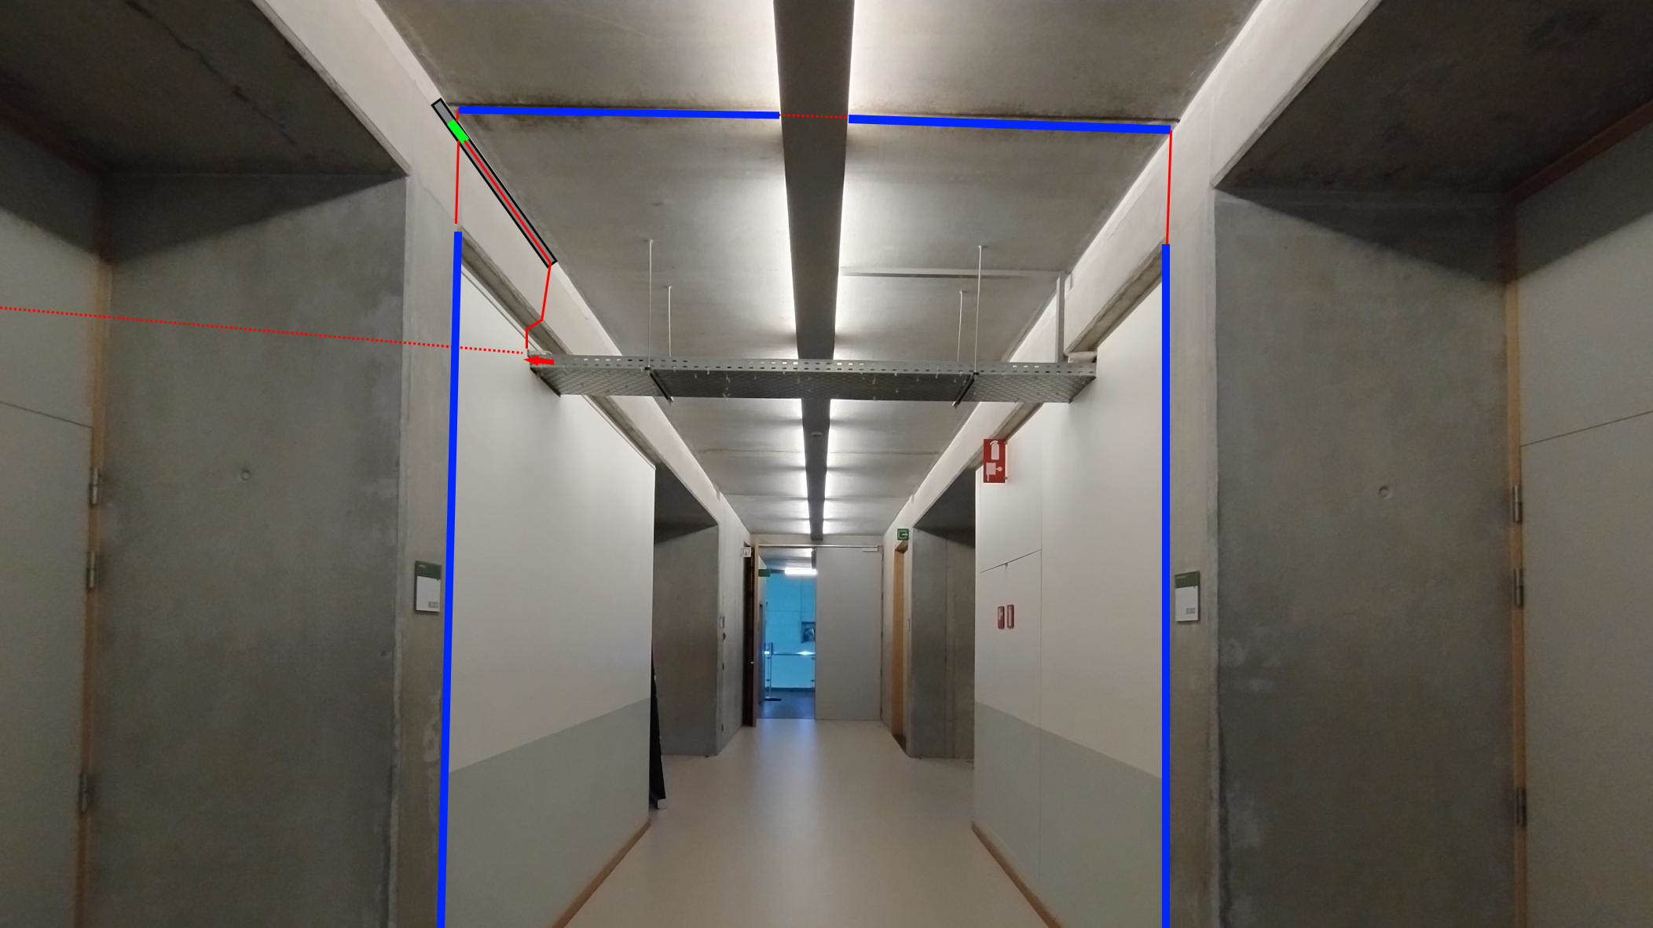
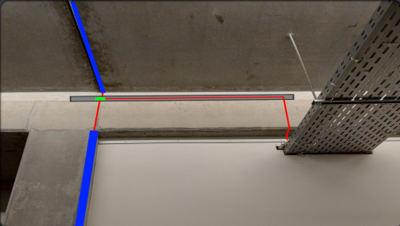

Slide 7
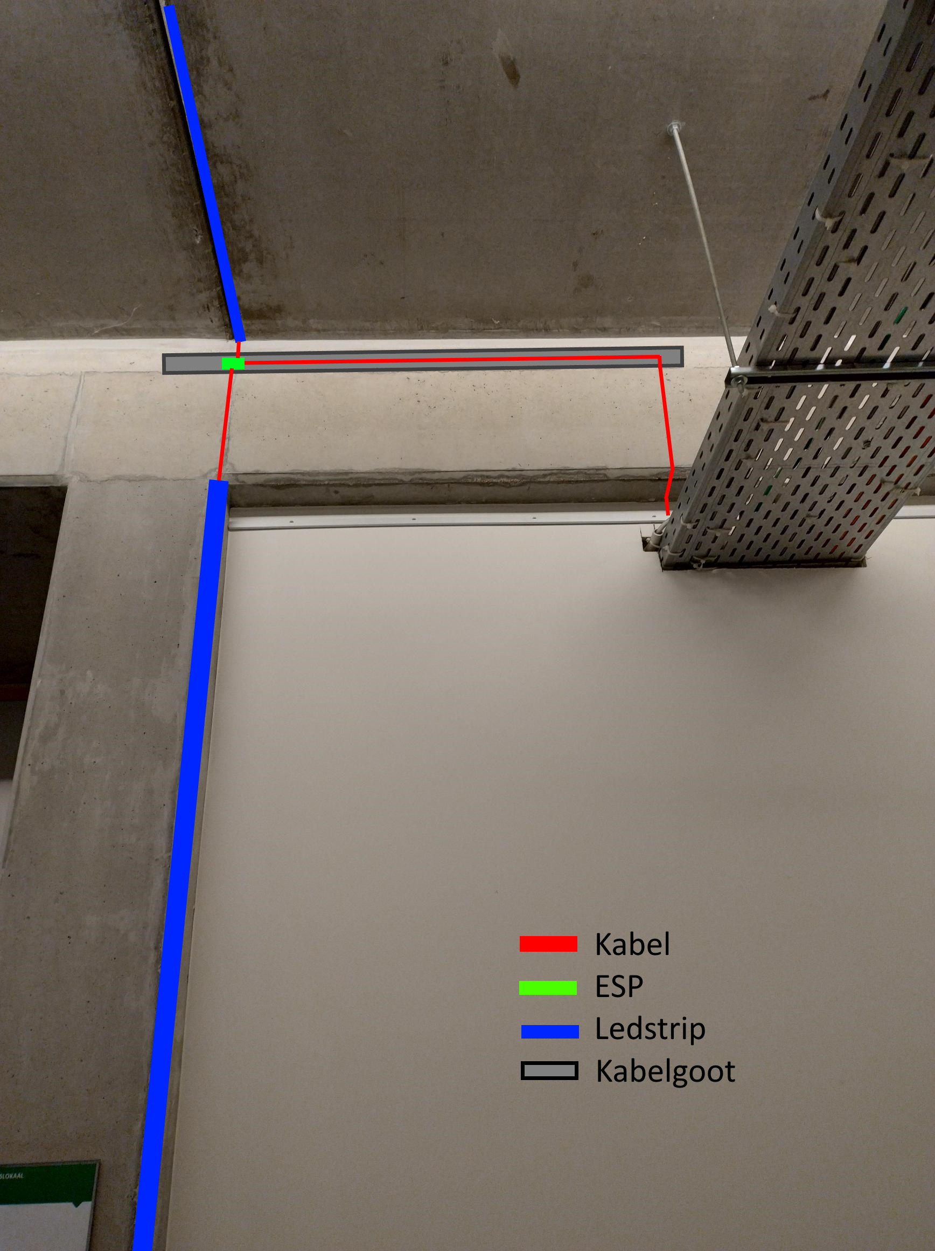

Slide 8
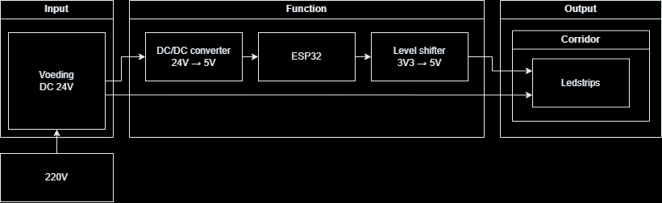
Hardware architecture diagram

Slide 9
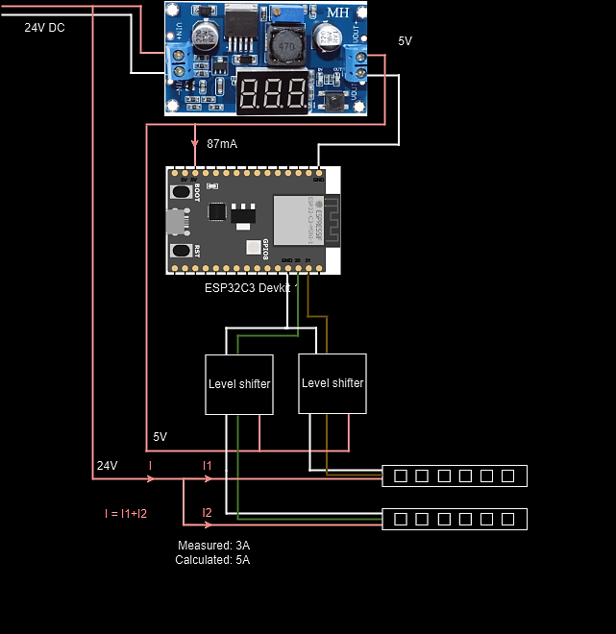
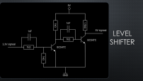
Wiring diagram

Slide 10
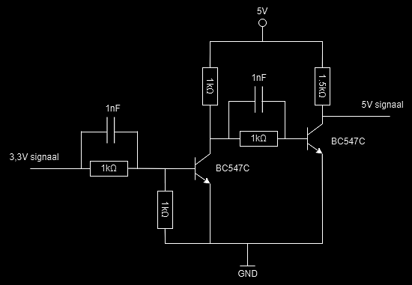
Level shifter

Slide 11
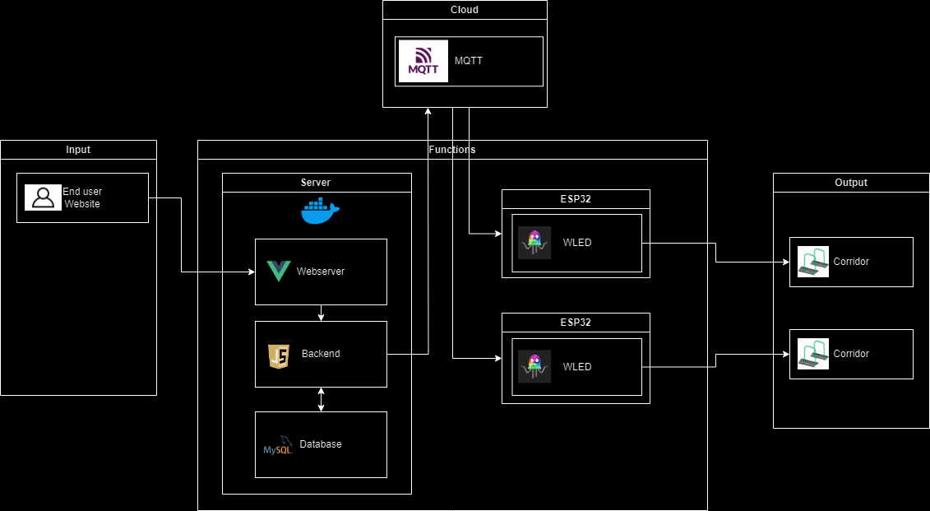
Software architecture diagram

Slide 12
Programming languages
Vue
Typescript
Javascript
CSS
Docker
HTML

Slide 13
Problems
Late deliveries
Going over budget

Slide 14
Solutions
Using own materials
Request a bigger budget

Slide 15
Succes?
Interactive ledstrips
Controlled by website
Easy to expand

Slide 16
Demo

Slide 17

Questions?

Slide 18

The end

